Slide 1














Calmera
a step in the right direction
1

Slide 2
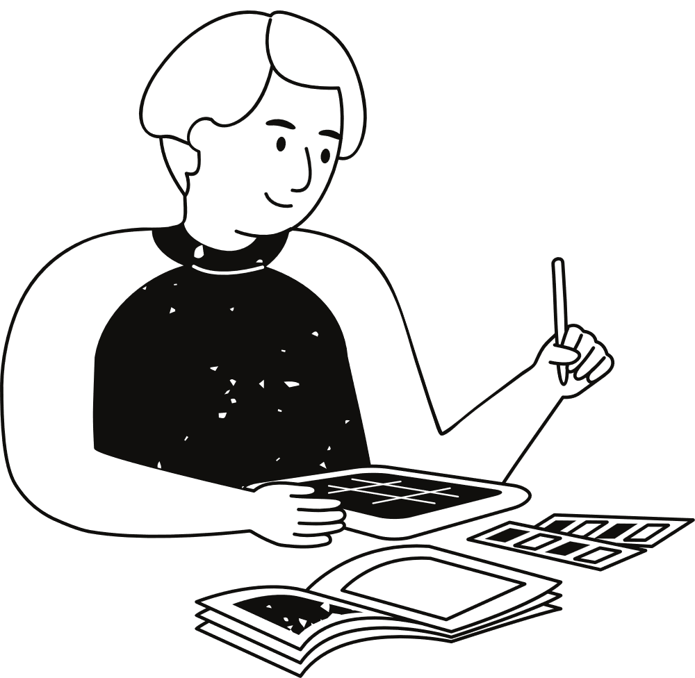
Origin of the Calmera
The need for social connection is relevant in this day of age where people are connected on devices but feel more distant than ever . Studies show 1 in 5 people have reported feeling lonely and more amongst adolescents and young adults. We saw a need to step in as Calmera. Contributing to better mental health
2

Slide 3
Mental Health and its pillars
01.
Physical Health
02.
Mental health is a broad topic but it can be broken down into manageable sub-topics that while define the term more clearly. These are the key points that the app will focus on to help the user of Calmera
Mental Health
03.
Relationship Health
04.
Mindfullness
3

Slide 4
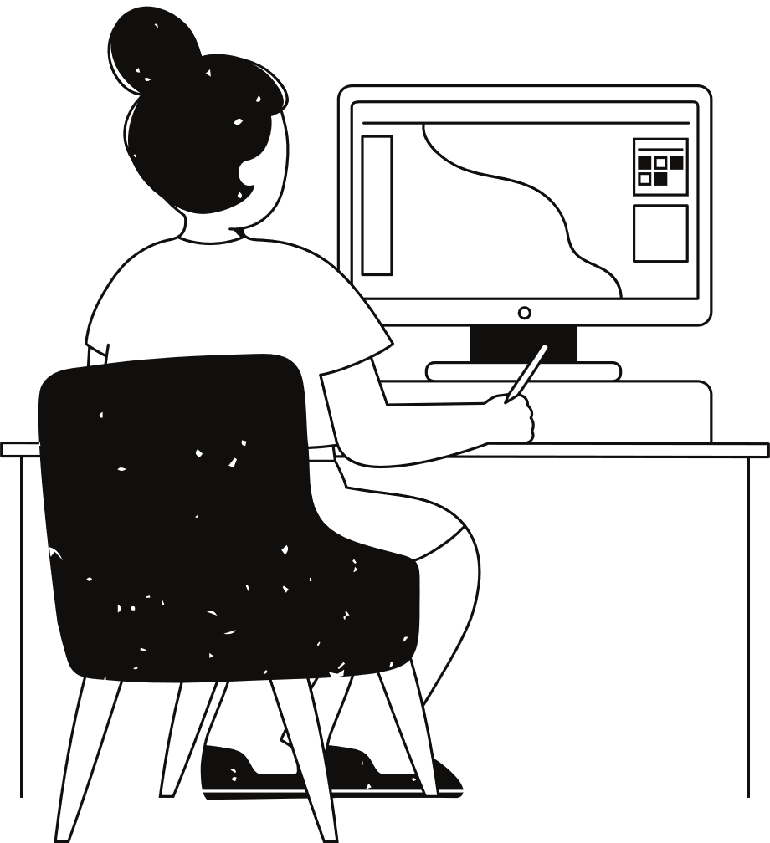

Calmera meeting the need
4

Slide 5
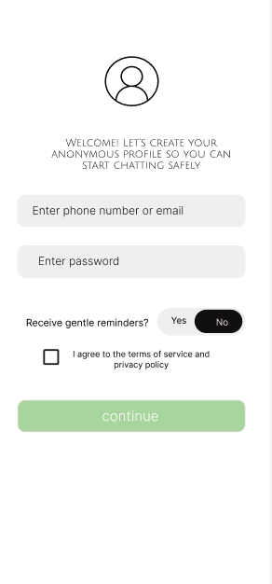

What Calmera has in store
An app that puts the needs of the user in hand, The need to help navigate their emotions after a demanding day . It brings awareness to the importance of ones mental health and makes the user have a consistant relationship with what they are feeling and to actively work on their state of mind daily
5

Slide 6

The problem
- Many hesitate to seek help due to stigma or judgment
- Professional help can be expensive or unavailable 24/7
- People often feel isolated without a safe space to share

Slide 7
Solution
- Anonymous profiles for safe, judgment-free conversations
- AI chatbot for instant support
- Mental health tracking to observe moods and patterns
- Integrated South African helplines for professional guidance

Slide 8
Impact
- Reduces stigma by offering a safe, anonymous space
- Provides 24/7 immediate support
- Encourages self-awareness through mental health tracking
- Bridges the gap between casual support and professional help

Slide 9
Safety measures
- AI filters harmful content and detects crisis situations
- Optional mood tracking and notifications
- Encrypted, anonymous profiles
- Easy access to trusted helplines

Slide 10
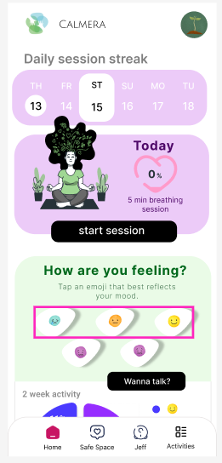
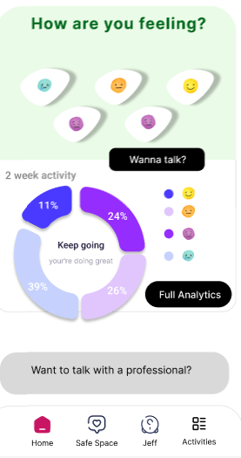
What Calmera has in store
Once Log in process has completed, the user will be welcomed by the home page that will show them what the applications offers . The ability to track daily progress on ones mental state and also track your daily activity on the task you take place
6

Slide 11
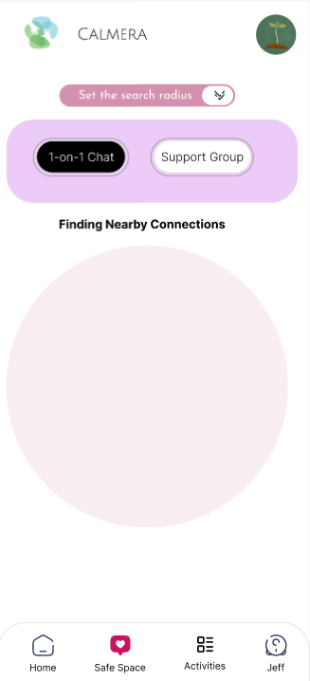
What Calmera has in store
It gives the users the ability to find 1 on 1 chats where the users available can communicate via text or call regarding on what both users agree on, it can even help people find support groups near give them a sense of belonging when they need it and want to speak out.
7

Slide 12
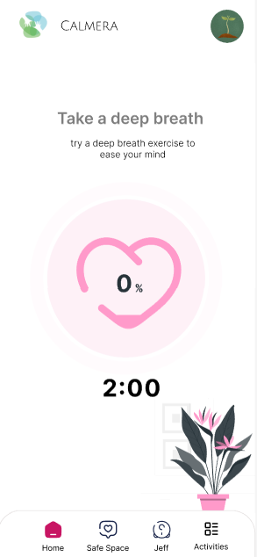
What Calmera has in store
It has daily activities and task that are placed there to better an individuals mood into bettering the mood of the user, Activities like breathing exercises, puzzle games , reminder to take meditation walks and many more that earn the user points that can be used to purchase in-app items for a customisable character avatar
8

Slide 13
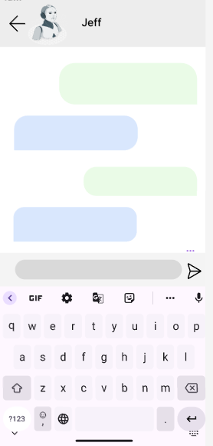
Calmera’s very own AI chatbot
Meet Jeff, your AI powered chatbot that is a friend without limit, gives advice on all things regarding mental health, he has been programed to think , talk and advice like a friend who has your back. Hardcoded with Psychological, mental and self-help books to give the user accurate responses to the questions the user will ask.
9

Slide 14
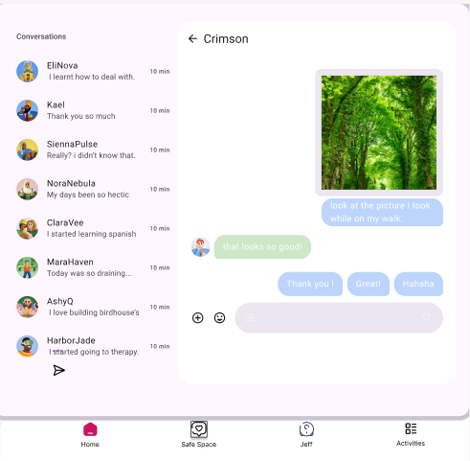
From Calmera
10

Slide 15
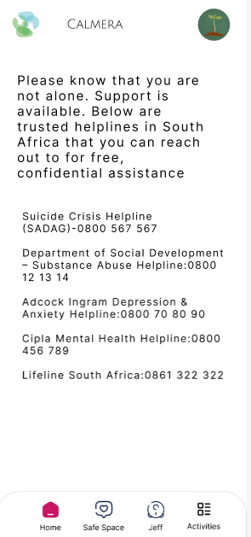
Final reflections on Calmera
This is an application that people need due to what they complain about, There is an untapped market that is needed for people of all ages which is the ability to converse ones problems, issues and struggles to a stranger to “vent” out what people bottle up, this can bring a massive decrease in suicide rates and improve moral among the people who use it . An app for the people who just want to be heard. Calmera is that app for them
11

Slide 16
Thank you very much!
From Calmera
12

